Slide 1

NHibernate and EF
Overview of Day 2

Slide 2
What’s an ORM do?
I need to get my objects into the database
ORM
objects
relational

Slide 3
ORM Advantages
Object-relational mapping advantages
Developer productivity
Writing less code
Abstract from differences between object and relational world
Complexity hidden within ORM
Manageability of the CRUD operations for complex relationships
Easier maintainability

Slide 4
Primary issues an ORM deals with
Mapping a class to one or more tables
Mapping properties to columns
Mapping inheritance hierarchy to one or more tables
CRUD on objects with all those maps
1:1, 1:M, M:1, M:N relationships
Dealing with object graphs and how much to load and when

Slide 5
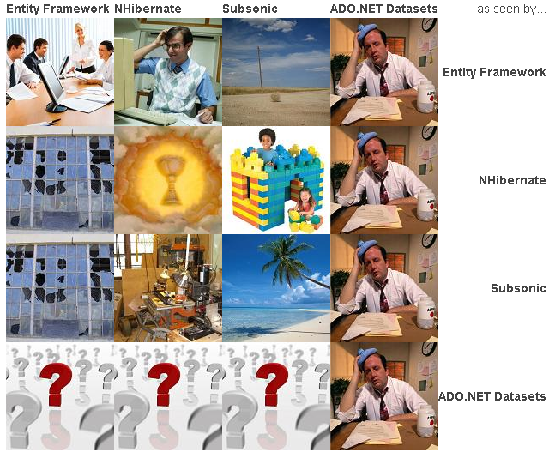
How each views the other

Slide 6
Models for ORM
Model | Characteristic
Code-First | Just take my C# objects and make a database from them
Database-first | Given a database, give me objects that let me access it without SQL
Model-first | I like UML – Create a database and objects from the model
This can be a religious battle
My opinion?
I believe in code-first
But database-first is usually how 98% of the reality
Model-first? Meh.

Slide 7
.NET ORM’s
Entity Framework
NHibernate
LINQ to SQL
Subsonic

Slide 8
We will look at the big-two…
EF
NHibernate

Slide 9
Models for both
NHibernate | Primarily database first, but can do code-first. 3rd party tools exist to do all three models
EF | Now support all three in VS.NET as of v6.0. But there are caveats to each. My $0.02? Database first is the best.

Slide 10
What we will examine in each
Some history and theory
Primarily database-first
How code-first can be used to create a database
How to map basic entities into database constructs
CRUD operations on classes
Navigating relationships
Lazy and eager loading

Slide 11
Onto the ORM’s

